Slide 1
Transformers - III
Lecture 8
Part 3
Generative AI for Computer Vision

Slide 2
Content
Transformer – Basics
Transformer for Vision Tasks
How Transformer differs from CNN?
Transformer Architecture
Transformer Encoder
  Input Embedding
  Positional Encoding

Slide 3
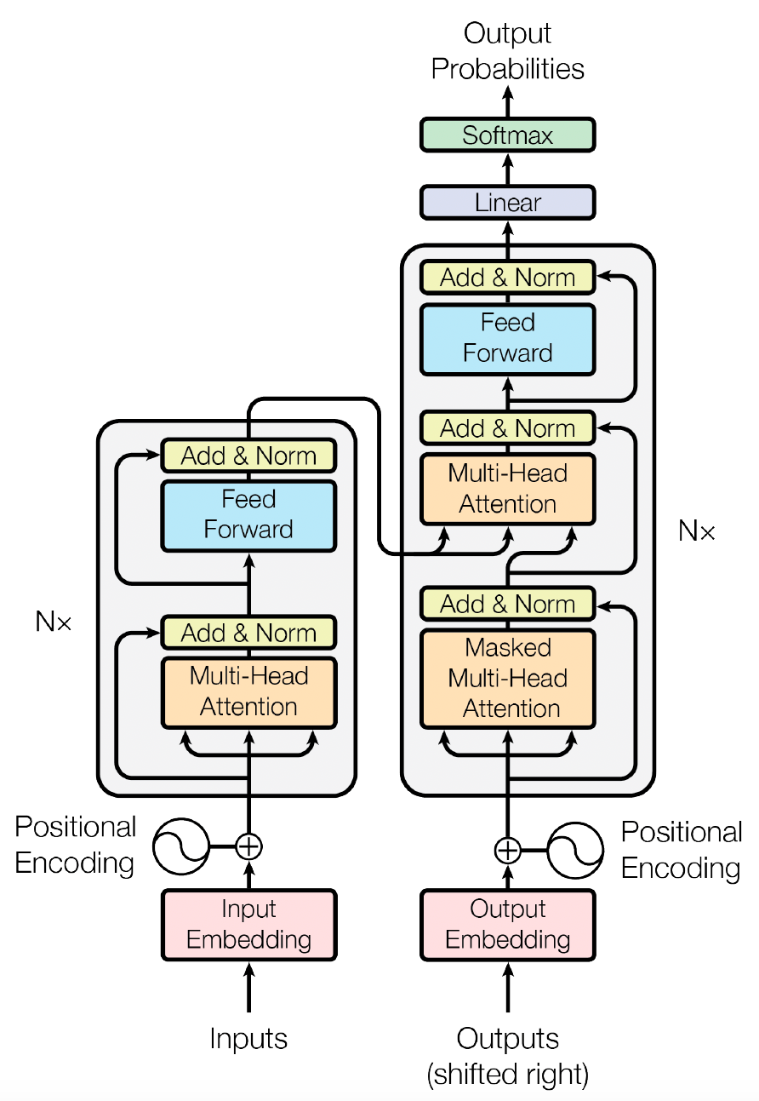
Transformers
Transformer is a powerful architecture for generative modelling that uses attention mechanisms to learn relationships between different elements of a sequence.
Attention allows the model to assign different levels of importance to input tokens when generating an output, enabling it to focus on the most relevant information.
A key component is self-attention, in which each token in a sequence interacts with every other token to determine their contextual relationships.
This enables the Transformer to understand dependencies between words or tokens, even when they are far apart in the sequence.
Figure Source: Ashish Vaswani et. al. Attention is All You Need, NIPS 2017

Slide 4
Transformers
Transformers further improve this process through multi-head attention, which runs several self-attention mechanisms in parallel, with each head learning to capture different types of relationships or patterns within the data.
By combining these attention mechanisms with positional information and feed-forward layers, Transformers can effectively model complex dependencies and generate coherent text, images, code, and other forms of data.
In generative models such as GPT, this architecture is used autoregressively, where the model predicts the next token based on the previously generated tokens, allowing it to produce new sequences that resemble the patterns learned during training.
Figure Source: Ashish Vaswani et. al. Attention is All You Need, NIPS 2017

Slide 5
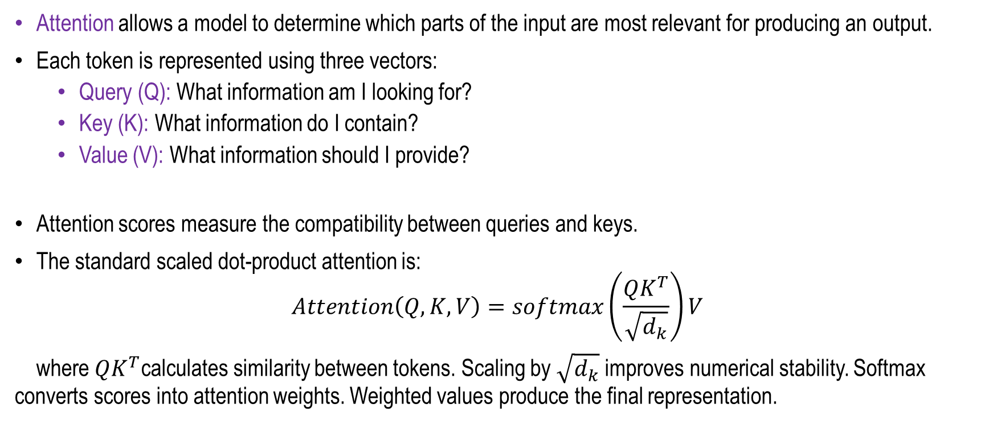
Attention Mechanism
Attention allows a model to determine which parts of the input are most relevant for producing an output.
Each token is represented using three vectors:
  Query (Q): What information am I looking for?
  Key (K): What information do I contain?
  Value (V): What information should I provide?
Attention scores measure the compatibility between queries and keys.
The standard scaled dot-product attention is:
$$Attention\left(Q,K,V\right)=softmax\left(\frac{QK^{T}}{\sqrt{d_{k}}}\right)V$$
where $QK^{T}$calculates similarity between tokens. Scaling by $\sqrt{d_{k}}$ improves numerical stability. Softmax converts scores into attention weights. Weighted values produce the final representation.

Slide 6
Transformer for Vision Tasks
Transformers can be used for computer vision by treating an image as a sequence of smaller regions, or patches, rather than processing the entire image at once.
For example, in the Vision Transformer (ViT), an image is divided into fixed-size patches, such as 16×16 pixels, and each patch is converted into a numerical vector called an embedding.
These patch embeddings are then given positional information so that the model can understand where each patch is located in the image.
The embeddings are passed through Transformer encoder layers, which use self-attention to learn relationships between different parts of the image.
This allows the model to identify both local features and long-range dependencies, such as relationships between objects that are far apart. The resulting representations can then be used for tasks such as image classification, object detection, image segmentation, and image generation.
Thus, Transformers provide a powerful alternative to traditional convolutional neural networks (CNNs) for many computer vision applications.

Slide 7

How Transformer works differently than CNN?
Convolution
Low Level Features
Suppose an image contains a person holding a flag.
A CNN uses convolutional filters to first identify local features such as edges, shapes, and textures. As the information moves through deeper layers, the CNN gradually combines these local features to understand that the person is holding the flag.
Non-linear Activation
Mid-Level Features
Normalization
High-Level Features
Pooling
Fully Connected layers
Softmax
Predictions

Slide 8
How Transformer works differently than CNN?
A Transformer, on the other hand, conceptually divides the image into patches and uses self-attention to determine how important each patch is to every other patch.
It can directly learn that the patch containing the person's hand is related to the patch containing the flag, even if they are relatively far apart.
CNNs are naturally good at learning local patterns and spatial features, while Transformers are particularly powerful at learning relationships between different regions of an image.
Modern vision systems often combine ideas from both approaches to get the advantages of each.

Slide 9
Transformer Architecture
Extract spatial
features from a
pretrained CNN
CNN
Encoder: c = T_{w}(z)
Where z is spatial CNN features
T_{w}(.) is the transformer encoder
Features :
H x W x D
z_{0,0}
z_{0,1}
z_{0,2}
z_{1,0}
z_{1,1}
z_{1,2}
z_{2,0}
z_{2,1}
z_{2,2}
[START]
boy
waving
flag
z_{0,0}
z_{0,1}
z_{0,2}
…
z_{2,2}
y₀
y₁
y₂
y₃
Transformer Encoder
Transformer Decoder
c_{0,0}
c_{0,1}
c_{0,2}
…
c_{2,2}
y₁
y₂
y₃
y₄
boy
waving
flag
[END]

Slide 10
Transformer Architecture
It consists of two main components:
  Encoder: converts the input sequence into contextualized representations.
  Decoder: generates the output sequence autoregressively using the encoder representations.
Figure Source: Ashish Vaswani et. al. Attention is All You Need, NIPS 2017

Slide 11
Transformer Architecture
z₀₀
Boy
z₀₁
Waving
TRANSFORMER
ENCODER
TRANSFORMER
DECODER
.
.
.
Flag
z₂₂
[END]
z_{0,0}
z_{0,1}
z_{0,2}
CNN
z_{0,0}
z_{0,1}
z_{0,2}
…
z_{2,2}
z_{1,0}
z_{1,1}
z_{1,2}
z_{2,0}
z_{2,1}
z_{2,2}
Figure Source: Ashish Vaswani et. al. Attention is All You Need, NIPS 2017

Slide 12
Transformer Architecture
Is
mac
léinn
mé
ENCODER
DECODER
ENCODER
DECODER
ENCODER
DECODER
ENCODER
DECODER
ENCODER
DECODER
ENCODER
DECODER
I
am
a
student
Figure Source: Ashish Vaswani et. al. Attention is All You Need, NIPS 2017

Slide 13
Full Encoder at a glance
Positional Encoding
Is
MULTI-HEAD ATTENTION
LAYER NORMALIZATION
FEED FORWARD NEURAL NETWORK
mac
To next encoder layer
léinn
mé
Word Embedding
Input to encoder
Add & Normalization
Add & Normalization
Figure Source: Ashish Vaswani et. al. Attention is All You Need, NIPS 2017

Slide 14
Full Encoder at a glance
Positional Encoding
Is
MULTI-HEAD ATTENTION
LAYER NORMALIZATION
FEED FORWARD NEURAL NETWORK
mac
To next encoder layer
léinn
mé
Word Embedding
Input to encoder
Is
Add & Normalization
Add & Normalization
mac
ENCODER
ENCODER
ENCODER
ENCODER
ENCODER
ENCODER
I
léinn
mé
am
DECODER
DECODER
DECODER
DECODER
DECODER
DECODER
a
student
Figure Source: Ashish Vaswani et. al. Attention is All You Need, NIPS 2017

Slide 15
Full Encoder at a glance
Is
mac
léinn
mé
Figure Source: Ashish Vaswani et. al. Attention is All You Need, NIPS 2017

Slide 16
Full Encoder at a glance
Is
mac
léinn
mé
Input Embedding
Figure Source: Ashish Vaswani et. al. Attention is All You Need, NIPS 2017

Slide 17
Input Embedding
Input embedding in a Transformer is the process of converting text tokens into numerical vector representations that the model can process mathematically.
The input text is first tokenized into smaller units, such as words, subwords, or individual tokens.
Each token is then mapped to a dense, fixed-dimensional vector using a learnable embedding matrix.
These embeddings provide a continuous representation of the tokens and allow the model to capture meaningful semantic and syntactic relationships between them.
During training, the embedding vectors are learned such that tokens with similar meanings or usage patterns tend to have similar representations in the vector space.
The resulting embeddings are then combined with positional information and supplied to the Transformer layers for further processing.
Figure Source: Ashish Vaswani et. al. Attention is All You Need, NIPS 2017

Slide 18
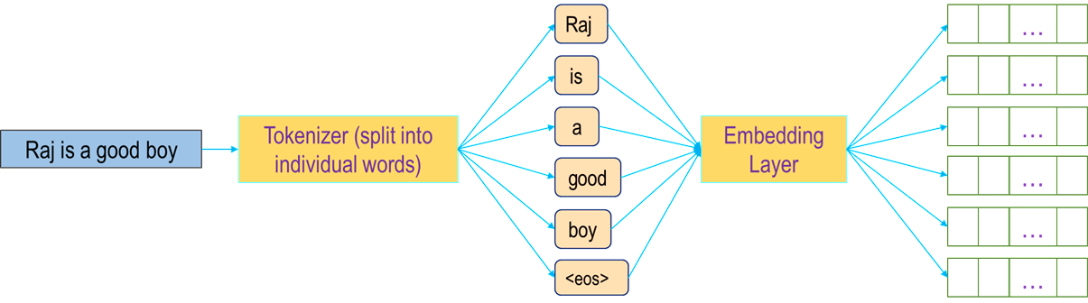
Encoder Architecture
Encoder
Raj
is
a
good
boy
Raj
is
Input Embedding
1
0.1
0.23
Input Embedding
2
0.39
0.06
3
-0.25
0.5
. . .
.
.
.
.
.
.
…
…
…
…
…
512
0.15
-0.51

Slide 19
Full Encoder at a glance
Positional Encoding
Is
mac
léinn
mé
Input Embedding
Figure Source: Ashish Vaswani et. al. Attention is All You Need, NIPS 2017

Slide 20
Transformer Architecture
Positional Encoding
Positional encoding is a technique used to provide information about the order and position of tokens within a sequence.
Since Transformers process all tokens in parallel and self-attention does not inherently encode their sequential order, the model requires additional positional information to distinguish between different token arrangements.
To address this, a unique positional vector is generated for each position in the sequence and added to the corresponding token embedding before the representation is passed into the Transformer layers.
This allows the model to incorporate information about the relative and absolute positions of tokens, enabling it to understand the order of words and capture relationships that depend on their positions within the sequence.
Figure Source: Ashish Vaswani et. al. Attention is All You Need, NIPS 2017

Slide 21
Transformer Architecture
Positional Encoding
Positional vectors are typically generated using sine and cosine functions with different frequencies, creating unique patterns for different positions in the sequence and enabling the model to capture relationships between positions.
These positional encodings are added to the corresponding token embeddings, allowing the Transformer to distinguish between sequences in which the same words appear in different orders.
For example, the sentences “dog bites man” and “man bites dog” contain the same words but have different meanings because their word order is different.
By incorporating positional information into the token representations, mechanisms such as self-attention can effectively capture both the contextual relationships and positional dependencies between tokens, enabling the model to better understand the structure and meaning of the sequence.

Slide 22
Transformer Architecture
Positional Encoding
• Positional information of each word in the i/p sentence.
• Relative distance (close / far) between words in the sentence.
Raj
is
good
boy
Raj
vector size 512
Word Embedding
…
…
…
…
close
is
Positional embedding
vector size: 512
computed once
Not learned
…
…
…
…
distant
good
boy
Encoder I/P
(512)
…
…
…
…

Slide 23
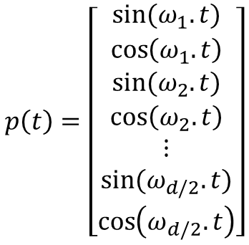
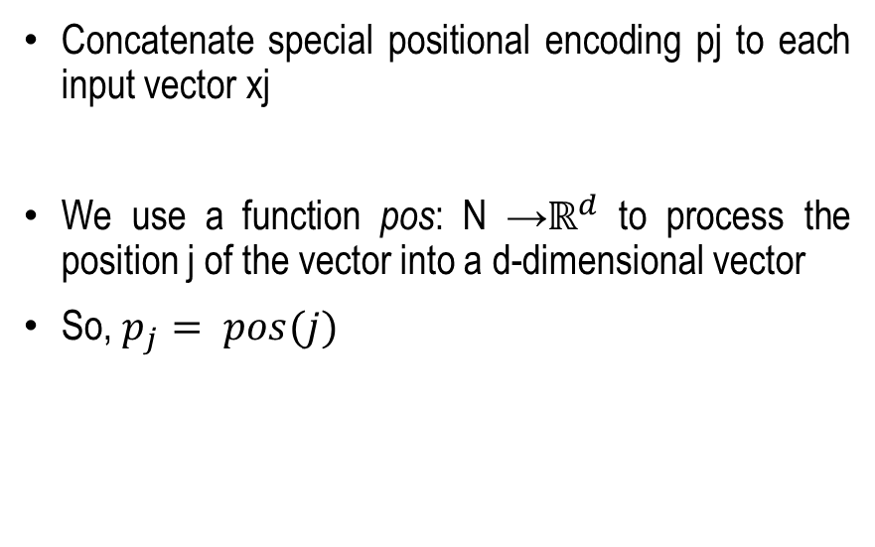
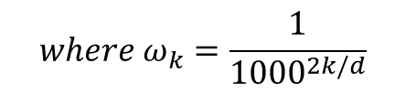
Transformer Architecture
Positional Encoding
Concatenate special positional encoding pj to each input vector xj
We use a function pos: N →$ℝ^{d}$ to process the position j of the vector into a d-dimensional vector
So, $p_{j}= pos(j)$
Options for pos(.)
  1. Learn a lookup table:
    Learn parameters to use for pos(t) for t ε [0, T)
    Lookup table contains T x d parameters.
  2. Design a fixed function with the desiderata
$$p\left(t\right)=\left[\begin{matrix}\begin{matrix}sin⁡(ω_{1}.t) \\ \cos\left(ω_{1}.t\right)\end{matrix} \\ \begin{matrix}sin⁡(ω_{2}.t) \\ \cos\left(ω_{2}.t\right)\end{matrix} \\ \begin{matrix}\begin{matrix}⋮ \\ sin⁡(ω_{d/2}.t)\end{matrix} \\ \cos\left(ω_{d/2}.t\right)\end{matrix}\end{matrix}\right]$$
$$where ω_{k}=\frac{1}{{1000}^{2k/d}}$$
Concept: Fei-Fei Li Attention and Transformers CS231n Stanford Lecture

Slide 24
Full Encoder at a glance
Input to Encoder
Positional Encoding
Is
mac
Encoder
léinn
mé
Word Embedding
Input to encoder
Figure Source: Ashish Vaswani et. al. Attention is All You Need, NIPS 2017

Slide 25
Summary
Transformer – Basics
Transformer for Vision Tasks
How Transformer differs from CNN?
Transformer Architecture
Transformer Encoder
  Input Embedding
  Positional Encoding

Slide 26
Transformers - IV
Next
Lecture 8: Part 5
Generative AI for Computer Vision

